Slide 1
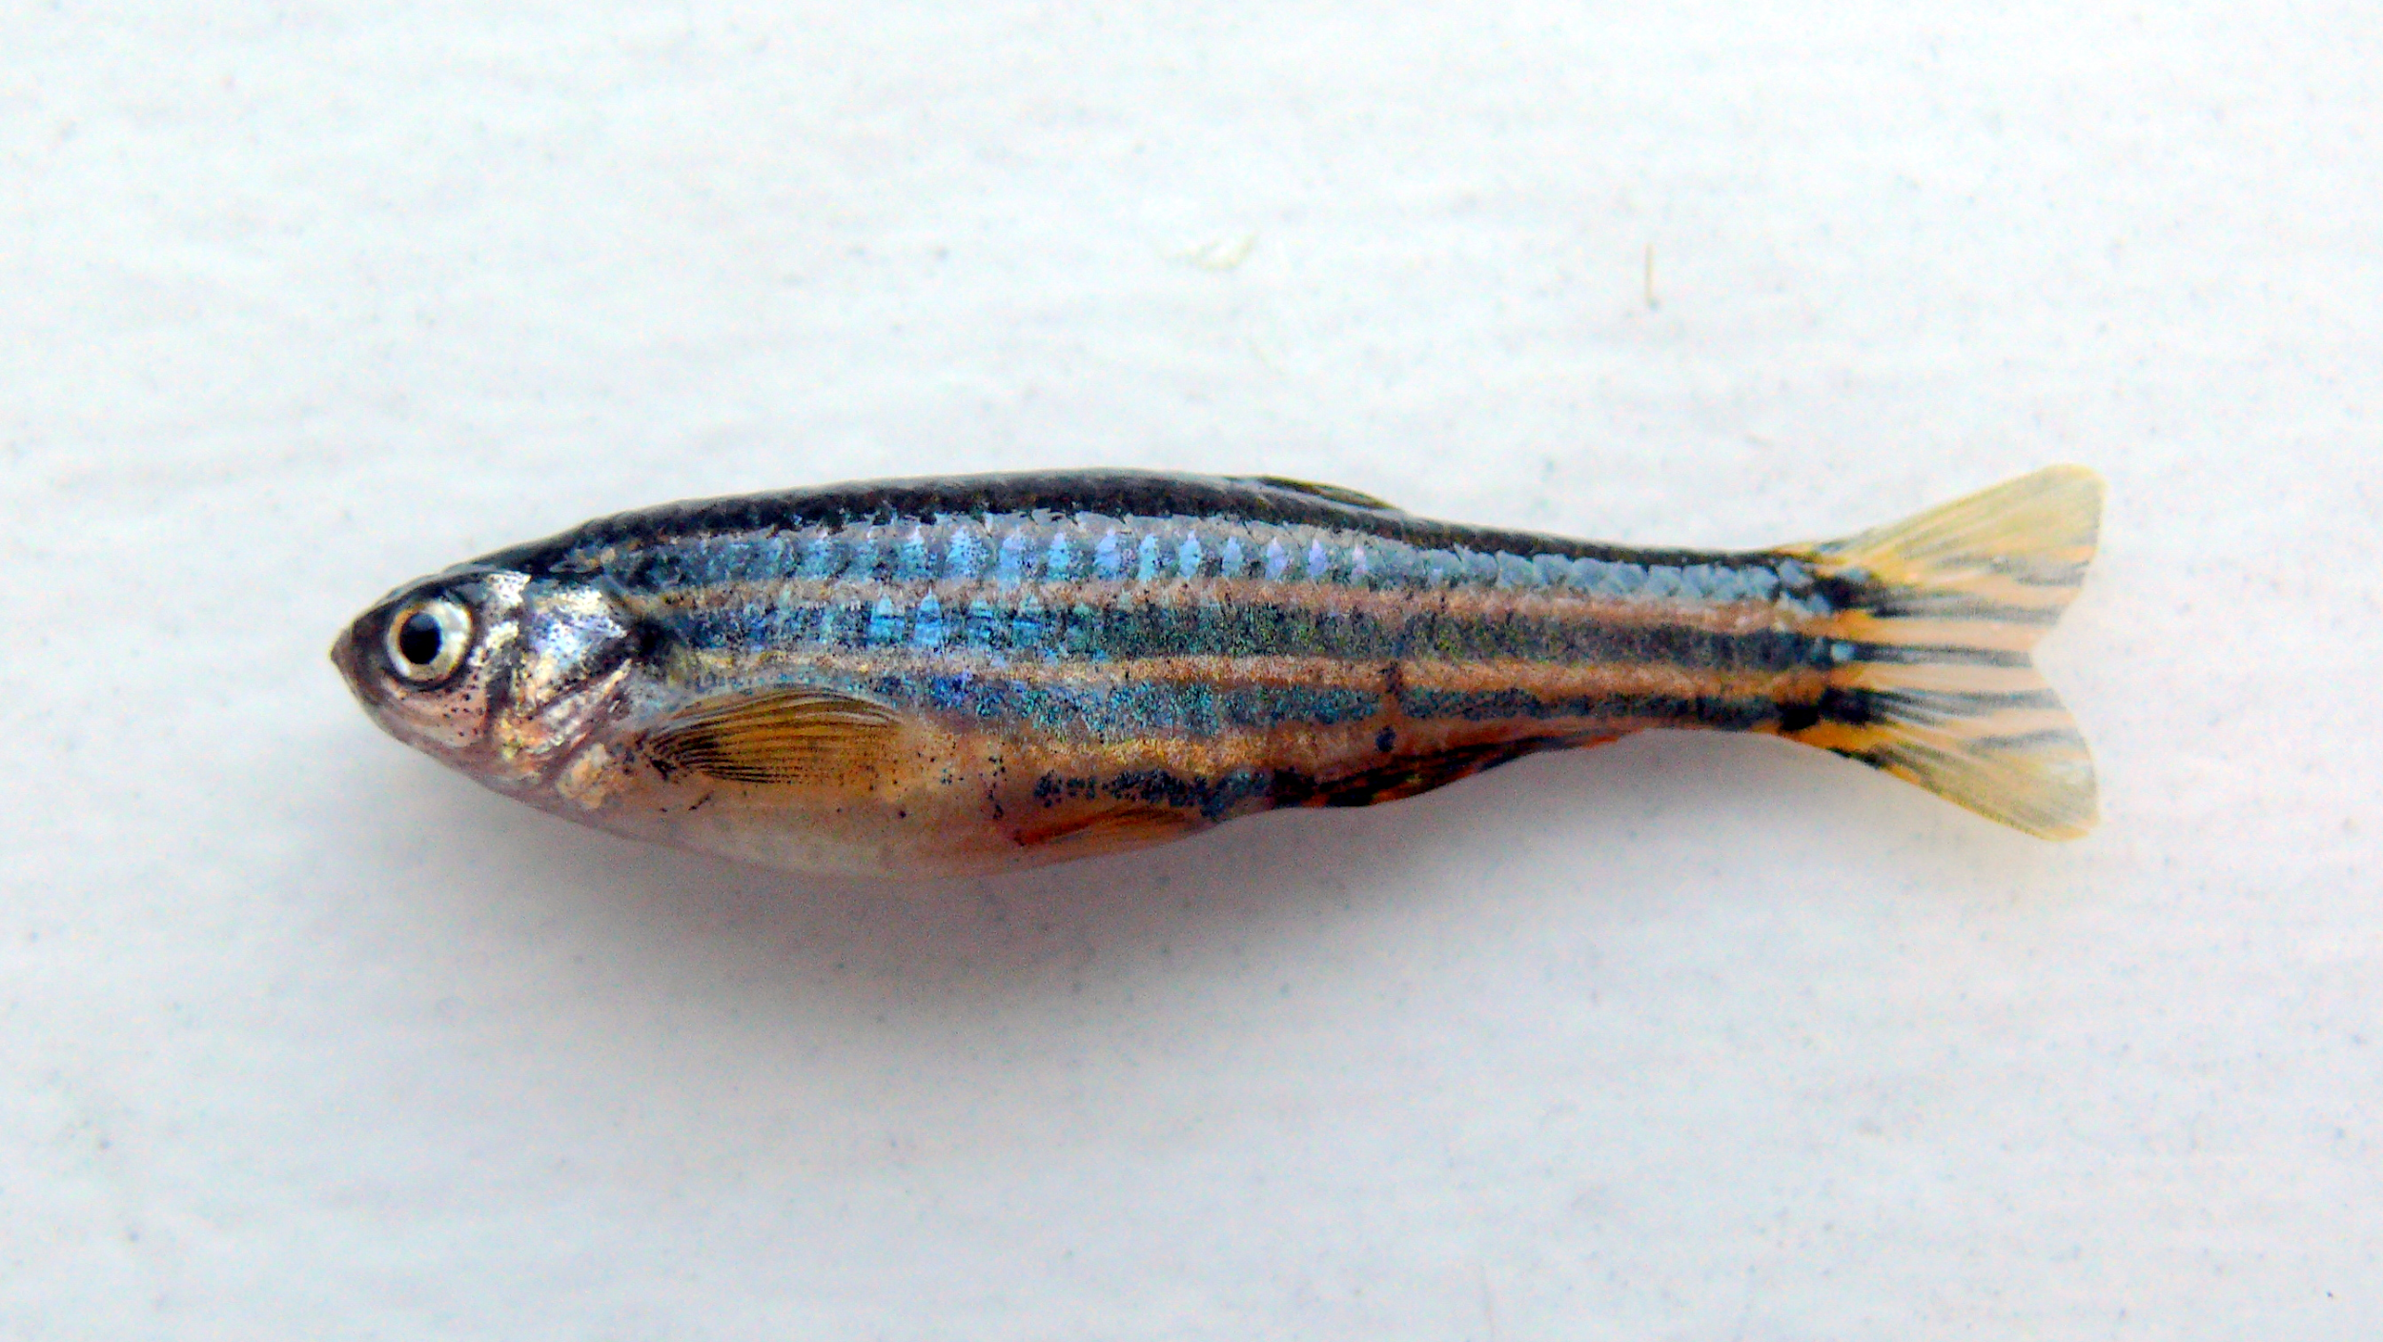

Lecture 4.3 – The Epigenetic Landscape of PTSD
Matt Eckelmeyer, Alison Gerber, Jason Chobirko, and Yogindra Raghav
Daniel Rawrio - The Zebrafish

Slide 2
Learning Objectives
Explain the mechanism and detection procedure for DNA Methylation marks.
Discuss the role of epigenomics in PTSD research.
Answer a figure-related question from PTSD research and identify what role DNA Methylation has.
Notes:
Work on the third learning objective and make it better

Slide 3
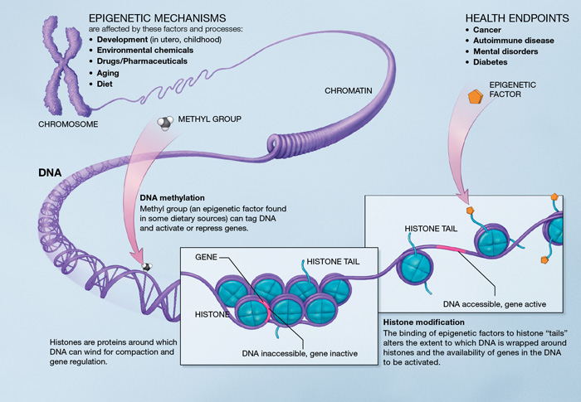
DNA Methylation Is A Key Epigenetic Modification
Image from: NIH
Notes:
Create an attention-grabber slide to grab the audience! Movie theme

Slide 4
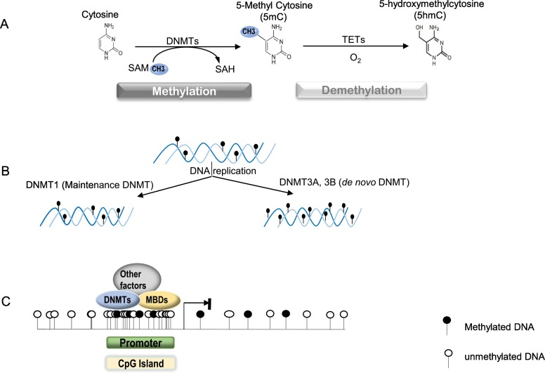
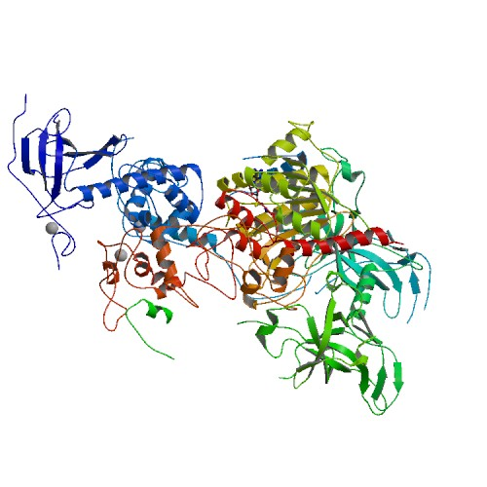
DNA Methyltransferase Is Responsible For Methylation of CpG Islands
Images:
X. Zhang, et al. BBA - Molecular Basis of Disease 1863, 2389-2397 (2017).
PDB

Slide 5
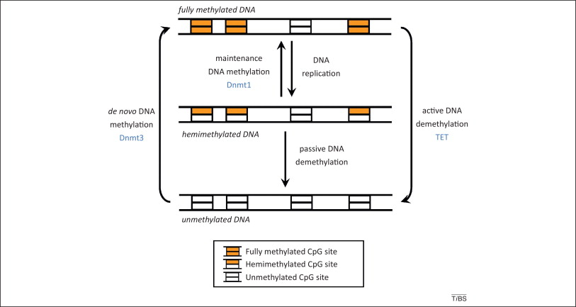
DNA Methylation is Categorized By Method
Image from:
A. Jeltsch, R. Z. Jurkowska. Trends in Biochemical Sciences 39, 310-318 (2014).

Slide 6
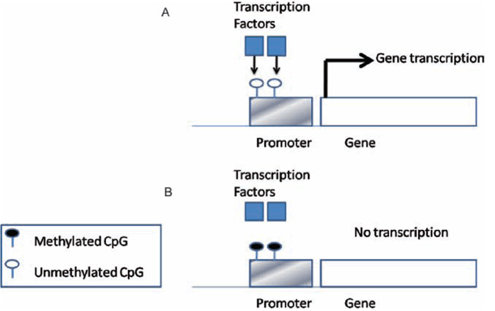
DNA Methylation in CpGI Promoters Decreases Transcription
Image from: D. H. K. Lim, E. R. Maher. The Obstretician & Gynecologist 12, 37-42 (2010).

Slide 7
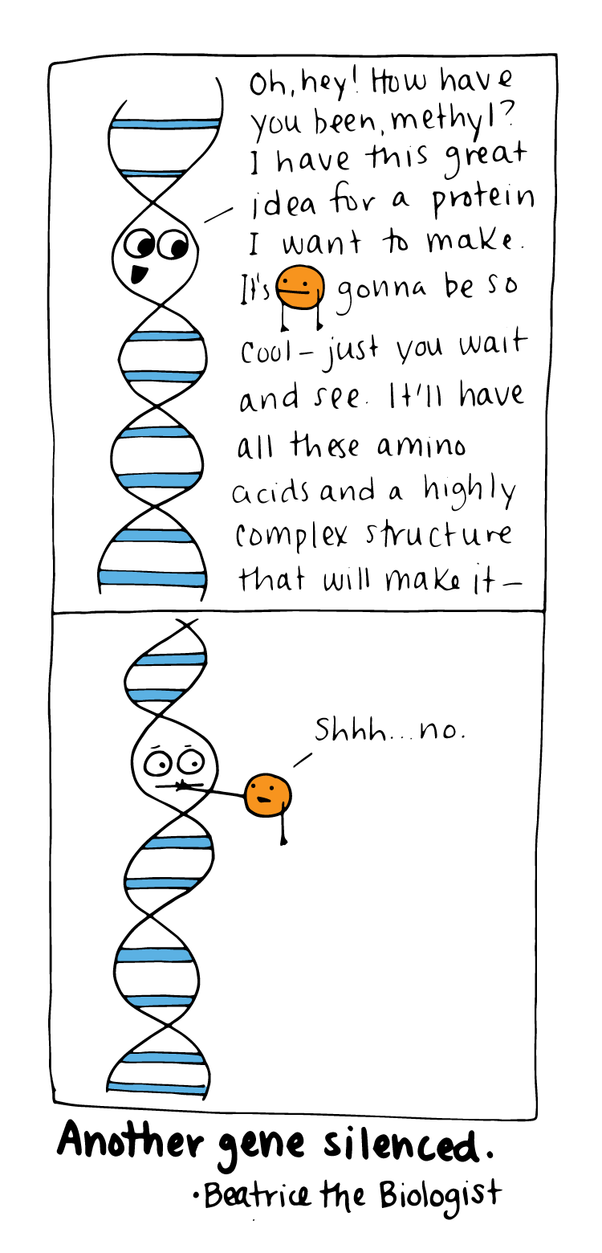
http://www.beatricebiologist.com/2016/06/gene-silencing/

Slide 8
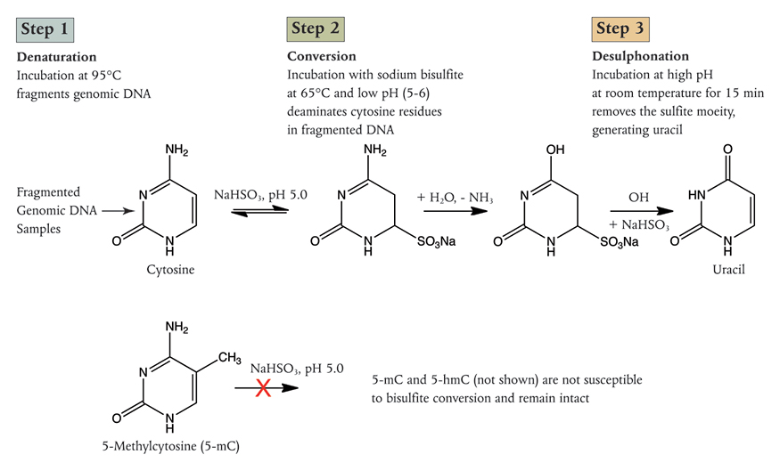
Bisulfite Treatment of Non-Methylated Cytosines Causes Conversion to Uracil
Image from: New England BioLabs

Slide 9
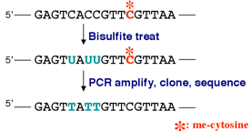
Bisulfite Sequencing Is A High Resolution Technique for DNA Methylation Detection
Image from:
Alpha BioLaboratory

Slide 10
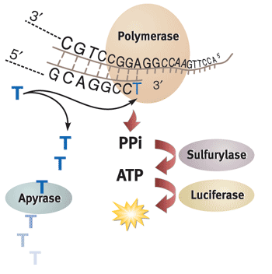
Bisulfite-DNA Pyrosequencing Technology Is Able To Accurately Help Detect Methylated Cytosines
Image from:
Center for Genomic Sciences, University of Hong Kong

Slide 11
Learning Objectives
Explain the mechanism and detection procedure for DNA Methylation marks.
Discuss the role of epigenomics in PTSD research.
Answer a figure-related question from PTSD research and identify what role DNA Methylation has.

Slide 12

Posttraumatic Stress Disorder (PTSD)
Image from:
psychcentral
Notes:
As we move on to learning objective 2, we will be focusing on our assigned reading which deals with Posttraumatic Stress Disorder

Slide 13
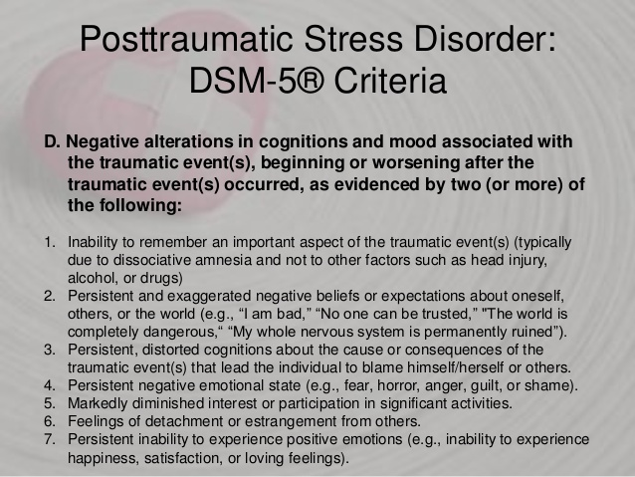
Posttraumatic Stress Disorder is a DSM-5-Classified Mental Disorder
Image from:
slideshare
Notes:
PTSD is a condition that is caused by one or many extreme bouts of trauma which alters an individual’s long-term cognitive state
Here we have the DSM-5 (Diagnostic Statistical Manual) diagnosis criteria for PTSD
The study from your assigned reading looks for an epigenomic basis for PTSD

Slide 14
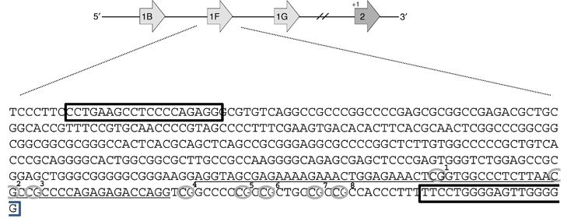
Altered DNA Methylation is Suspected in Many PTSD-Associated Genes
Image from:
Nature
Notes:
As we learned in lecture, DNA methylation is an epigenomic modification that can have a silencing effect on genes
Methylation occurs on Cytosine residues at a Cytosine-Guanine dinucleotide, commonly referred to as a CpG island
Previous studies have reported changes in CpG methylation levels of the glucocorticoid receptor gene (shown above).
This gene is one of many genes responsible for managing stress response in the body, which is altered in individuals with PTSD
The study from our assigned reading looks further into altered methylation in individuals with PTSD, at a genome-wide scale.
They do this by examining genome-wide methylation differences between individuals with and without PTSD
They started by looking at a “training” set of 99 combat veterans
Among these veterans, 48 had PTSD and 51 did not
Using Agilent Whole Genome array technology, they quantified the instances of CpG island methylation in both groups and compared the levels of methylation

Slide 15
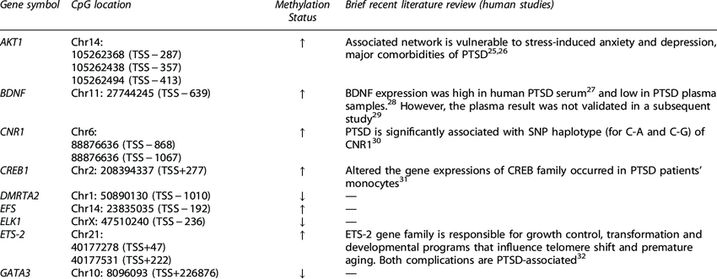
Genes Correlated With PTSD Were Identified From Differentially Methylated CpG Islands
R. Hammamieh, et al. Translational Psychiatry 7, 1-7 (2017).
Notes:
They found 5600 CpG sites that were differentially methylated between the samples, 1700 of which were located in promoter regions for genes
Furthermore, 84.5% were hypermethylation in the PTSD+ group, (indicating an increased level of methylation)
In order to reduce bias, they then repeated this analysis using a new group of 29 PTSD+ and 31 PTSD- combat veterans which they referred to as the “test” set
They used a different Illumina array platform for the “test” set, as well, to eliminate any kind of platform bias.
They then looked at genes associated with these differentially methylated CpG islands
Approximately 3600 genes were initially determined to be differentially methylated from the training set
This number was eventually reduced to 352 differentially methylated genes after cross-referencing the “training” set with the “test” set and including only CpG islands that exist in gene promoters in both sets
In doing this, they found that the majority of PTSD-associated genes that they identified were hypermethylated in PTSD+ individuals
They then compiled a list of these genes, along with their methylation status, in order to determine how these genes relate to PTSD

Slide 16
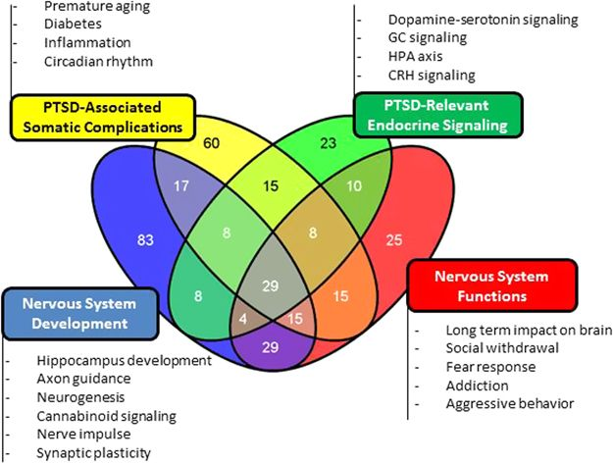
Four Clusters of PTSD-Related Gene Networks Were Derived From DMGs
R. Hammamieh, et al. Translational Psychiatry 7, 1-7 (2017).
Notes:
Alison START
4 clusters which are affected by PTSD but we will be focusing on PTSD-relevant endocrine signaling
Numbers in each section of this figure represent how many of the genes present with all of the symptoms encompassed in that circle (ie. 60 genes present with only PTSD associated somatic complications, 15 with both somatic and endocrine signaling symptoms)

Slide 17
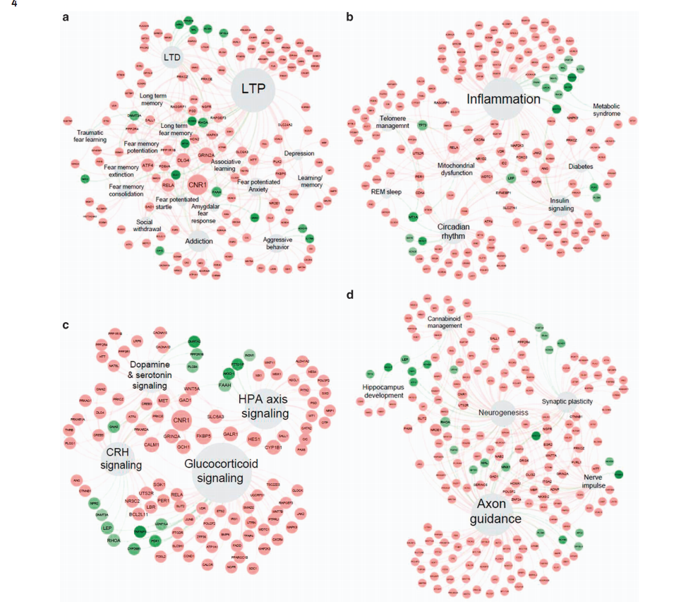
Hypermethylation is Enriched in All Four Clusters in PTSD+ Veterans
R. Hammamieh, et al. Translational Psychiatry 7, 1-7 (2017).
Notes:
Of all the genes found they se
Green indicates hypo and red indicates hyper
This is the chart showing the different methylation of each of the 4 clusters
With much more hypermethylation in the PTSD-relevant endocrine disorders than hypomethylation

Slide 18
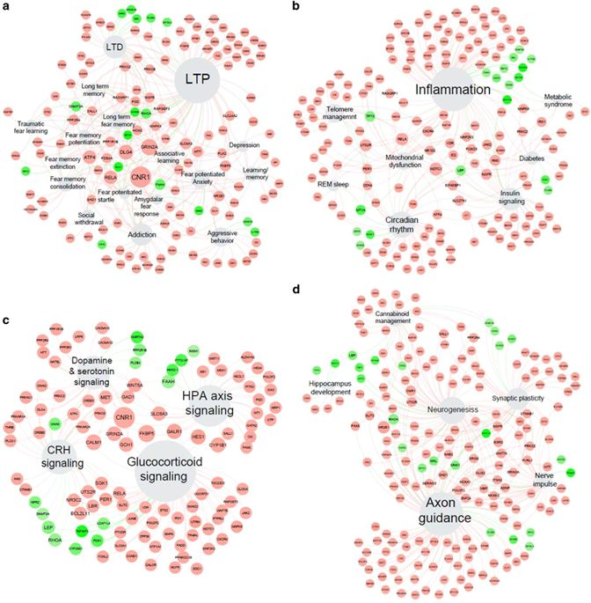
Endocrine Signaling Cluster Shows Hypermethylation of Glucocorticoid Genes
R. Hammamieh, et al. Translational Psychiatry 7, 1-7 (2017).
Notes:
CROP THIS FIGURE TO PART C AND MAKE HUGE
Glucocorticoids are defined as having a role in glucose metabolism, being made in the adrenal cortex, and taking on the chemical structure of a steroid
Figure includes glucocorticoid signaling which is hindered in individuals with PTSD due to almost all of the genes involved being hypermethylated
Shows connection this has to the rest of the bodily systems but most importantly the brain signaling reward and relaxation
Hypothalamus Pituitary Adrenal Axis which controls cortisol levels in response to stress
Heightened levels of cortisol make more glucose available for the fight or flight response which is malfunctioning in individuals with PTSD as is reasoned from “gluco” in glucocorticoids
Red dots are hypermethylated genes and thus those genes are turned off which attribute to the symptoms of PTSD
Green dots are hypomethylated genes and have not been silenced

Slide 19
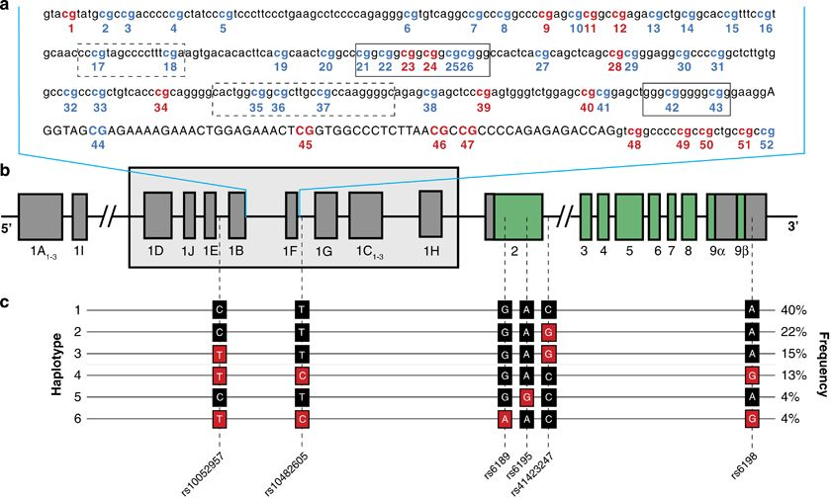
Cortisol Pathways are Less Effective in PTSD Sufferers, Increasing the Feelings of Stress
Schur, R.R., et al. Translational Psychiatry, 1-8 (2017)
Notes:
Figure A
Lowercase letters represent the promoter regions
Uppercase letters represent the GR-1 coding region of the NR3C1 gene
Cortisol pathway controlled ability to handle the stress brought on by the traumatic event
Solid black boxes within the light blue box represent canonical NGFI-A binding sites (canonical meaning a single sequence that will almost always bind to that promoter site)
Figure B
Exons are represented on the black horizontal line with the green regions are non-coding introns
These boxed exons are the exons expounded upon in figure A and then more broken down on the SNP’s shown in figure C
Figure C
Six common variations based on six SNP’s and their frequencies
Red letters represent minor alleles
in parallel to the black ones that if the black alleles are instead methylated the individual will have major changes to their coding regions and non-coding regions
CLARIFY 6 SNP’s correspond to exons 2-9 in the black box, not in the overall sequence
Alison’s Conclusion-
Cortisol pathway therapy would provide individuals with PTSD the supplemental cortisol they aren’t producing themselves which will help to elevate their PTSD symptoms
Epigenetic perturbation of the four previously mentioned networks relate to the Hypothalamus-Pituitary-Adrenal axis functions which regulates stress response rely upon the regulation of glucocorticoids like cortisol that change the binding abilities of serotonin and dopamine
So, through therapy that allows better regulation to bind cortisol and thus heightening the coping ability to an individual’s stress will allow the effects of serotonin and dopamine to be better felt lessening the symptoms of the individuals’ symptoms of PTSD
Overall, elevated cortisol levels longterm are not good but in the moment the cortisol response will alleviate the PTSD symptoms
Matt’s conclusion
As we conclude the lecture portion of our presentation, I’d like to highlight a few key points that we want you to remember
Bisulfite-treated DNA Pyrosequencing is one of the most common methods for DNA methylation mark detection
It involves a sequencing by synthesis reaction using light for incorporated bases
With the purpose of retaining methylated cytosines
Hypermethylation of CpG islands within promoter regions is prevalent in many PTSD-associated genes, resulting in decreased levels of transcription and an inability to cope with stress

Slide 20
Learning Objectives
Explain the mechanism and detection procedure for DNA Methylation marks.
Discuss the role of epigenomics in PTSD research.
Answer a figure-related question from PTSD research and identify what role DNA Methylation has.
Notes:
Make sure to use PTSD papers. Year-restriction not in place.
Use 3 figures in total. Multiple groups will get same figure.
Possibly make 2 questions for each figure. Then each group getting figure can do each one. (Possibly could avoid this and have each figure have questions that each group that gets that paper has to answer).

Slide 21
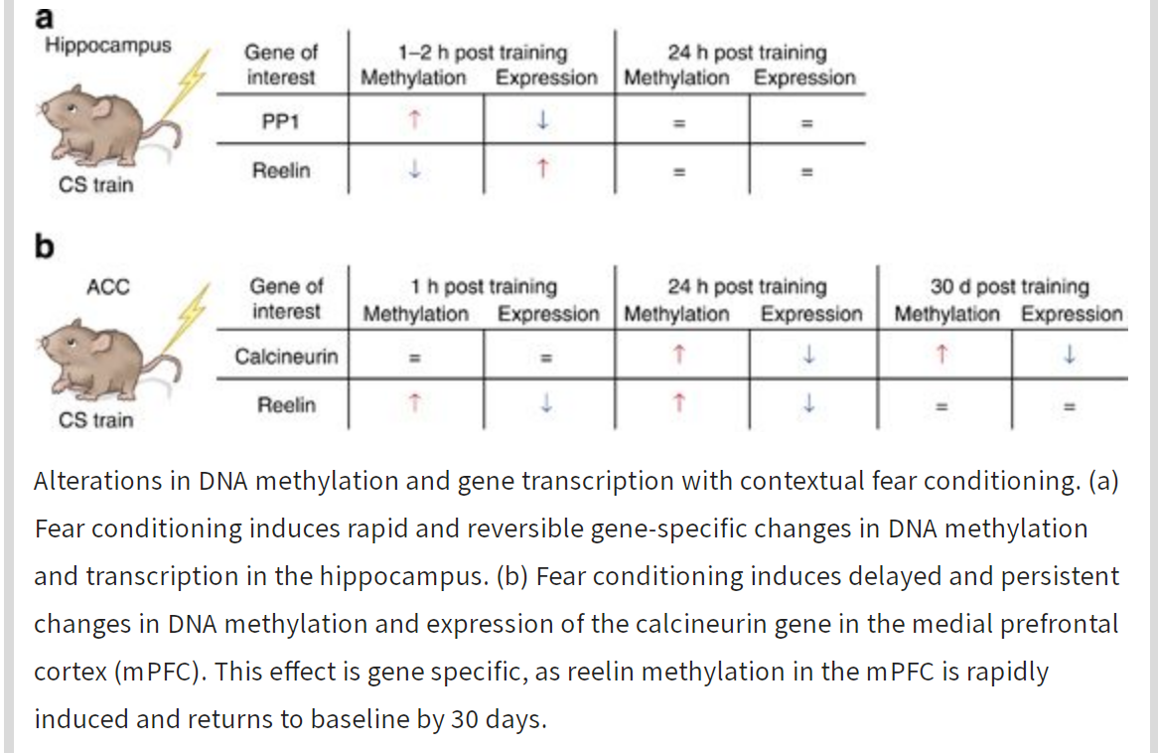
Figure 1
Zovkic, I. B., Sweatt, J. D. Epigenetic Mechanisms in Learned Fear: Implications for PTSD. Neuropsychopharmacology 38, 77-93 (2013).

Slide 22
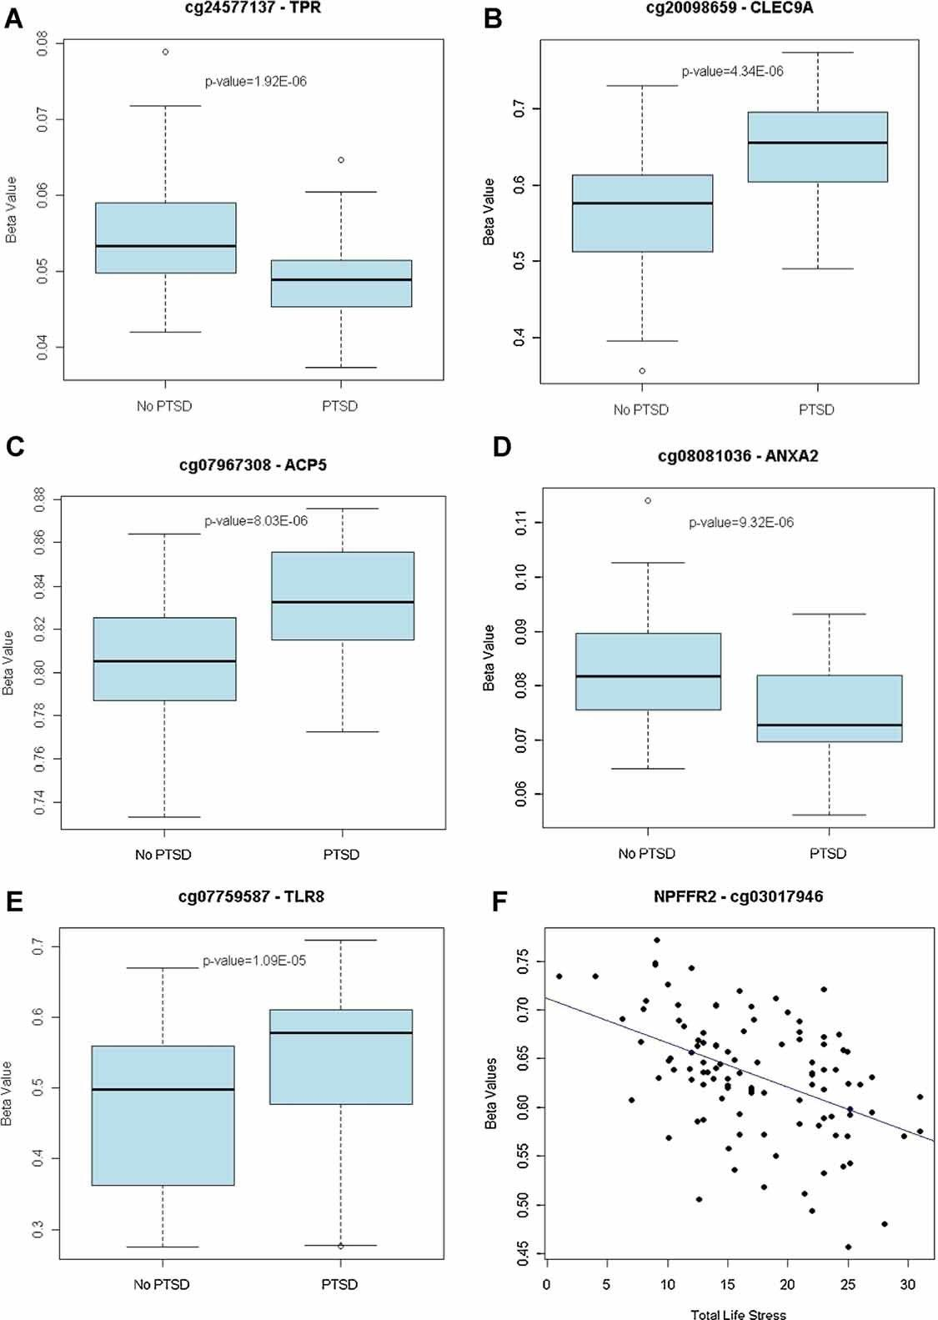
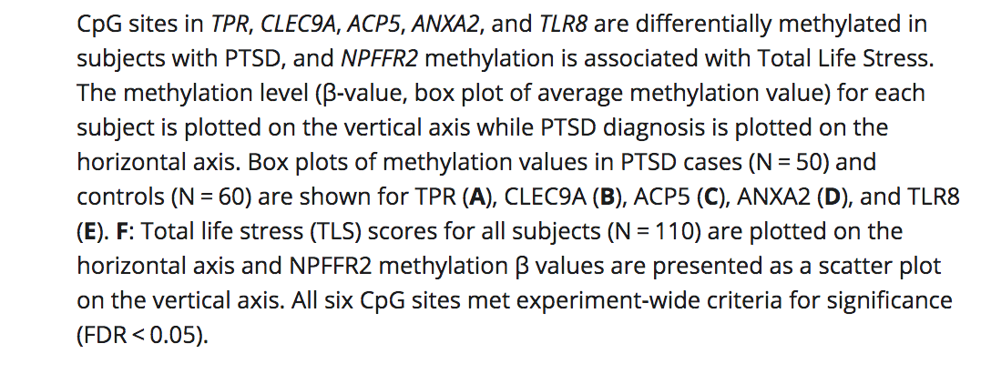
Figure 2
Smith A. K., et al. Differential Immune System DNA Methylation and Cytokine Regulation in Post‐Traumatic Stress Disorder. American Journal of Medical Genetics Part B 156, 700–708 (2011).

Slide 23
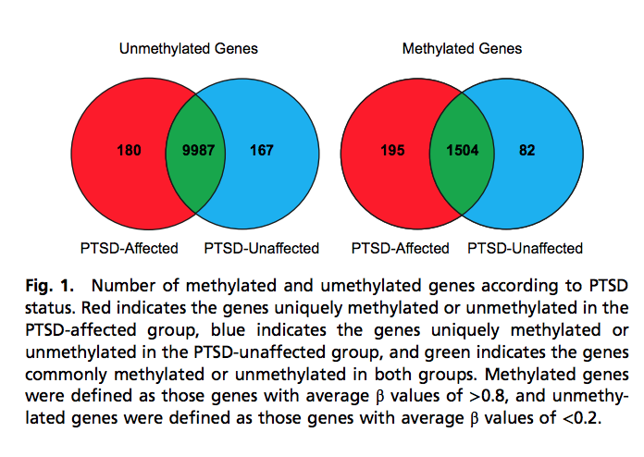
Figure 3
Uddin, M., et al. Epigenetic and immune function profiles associated with posttraumatic stress disorder. Proceedings of the National Academy of Sciences 107 (20) 9470-9475; (2010).

Slide 24
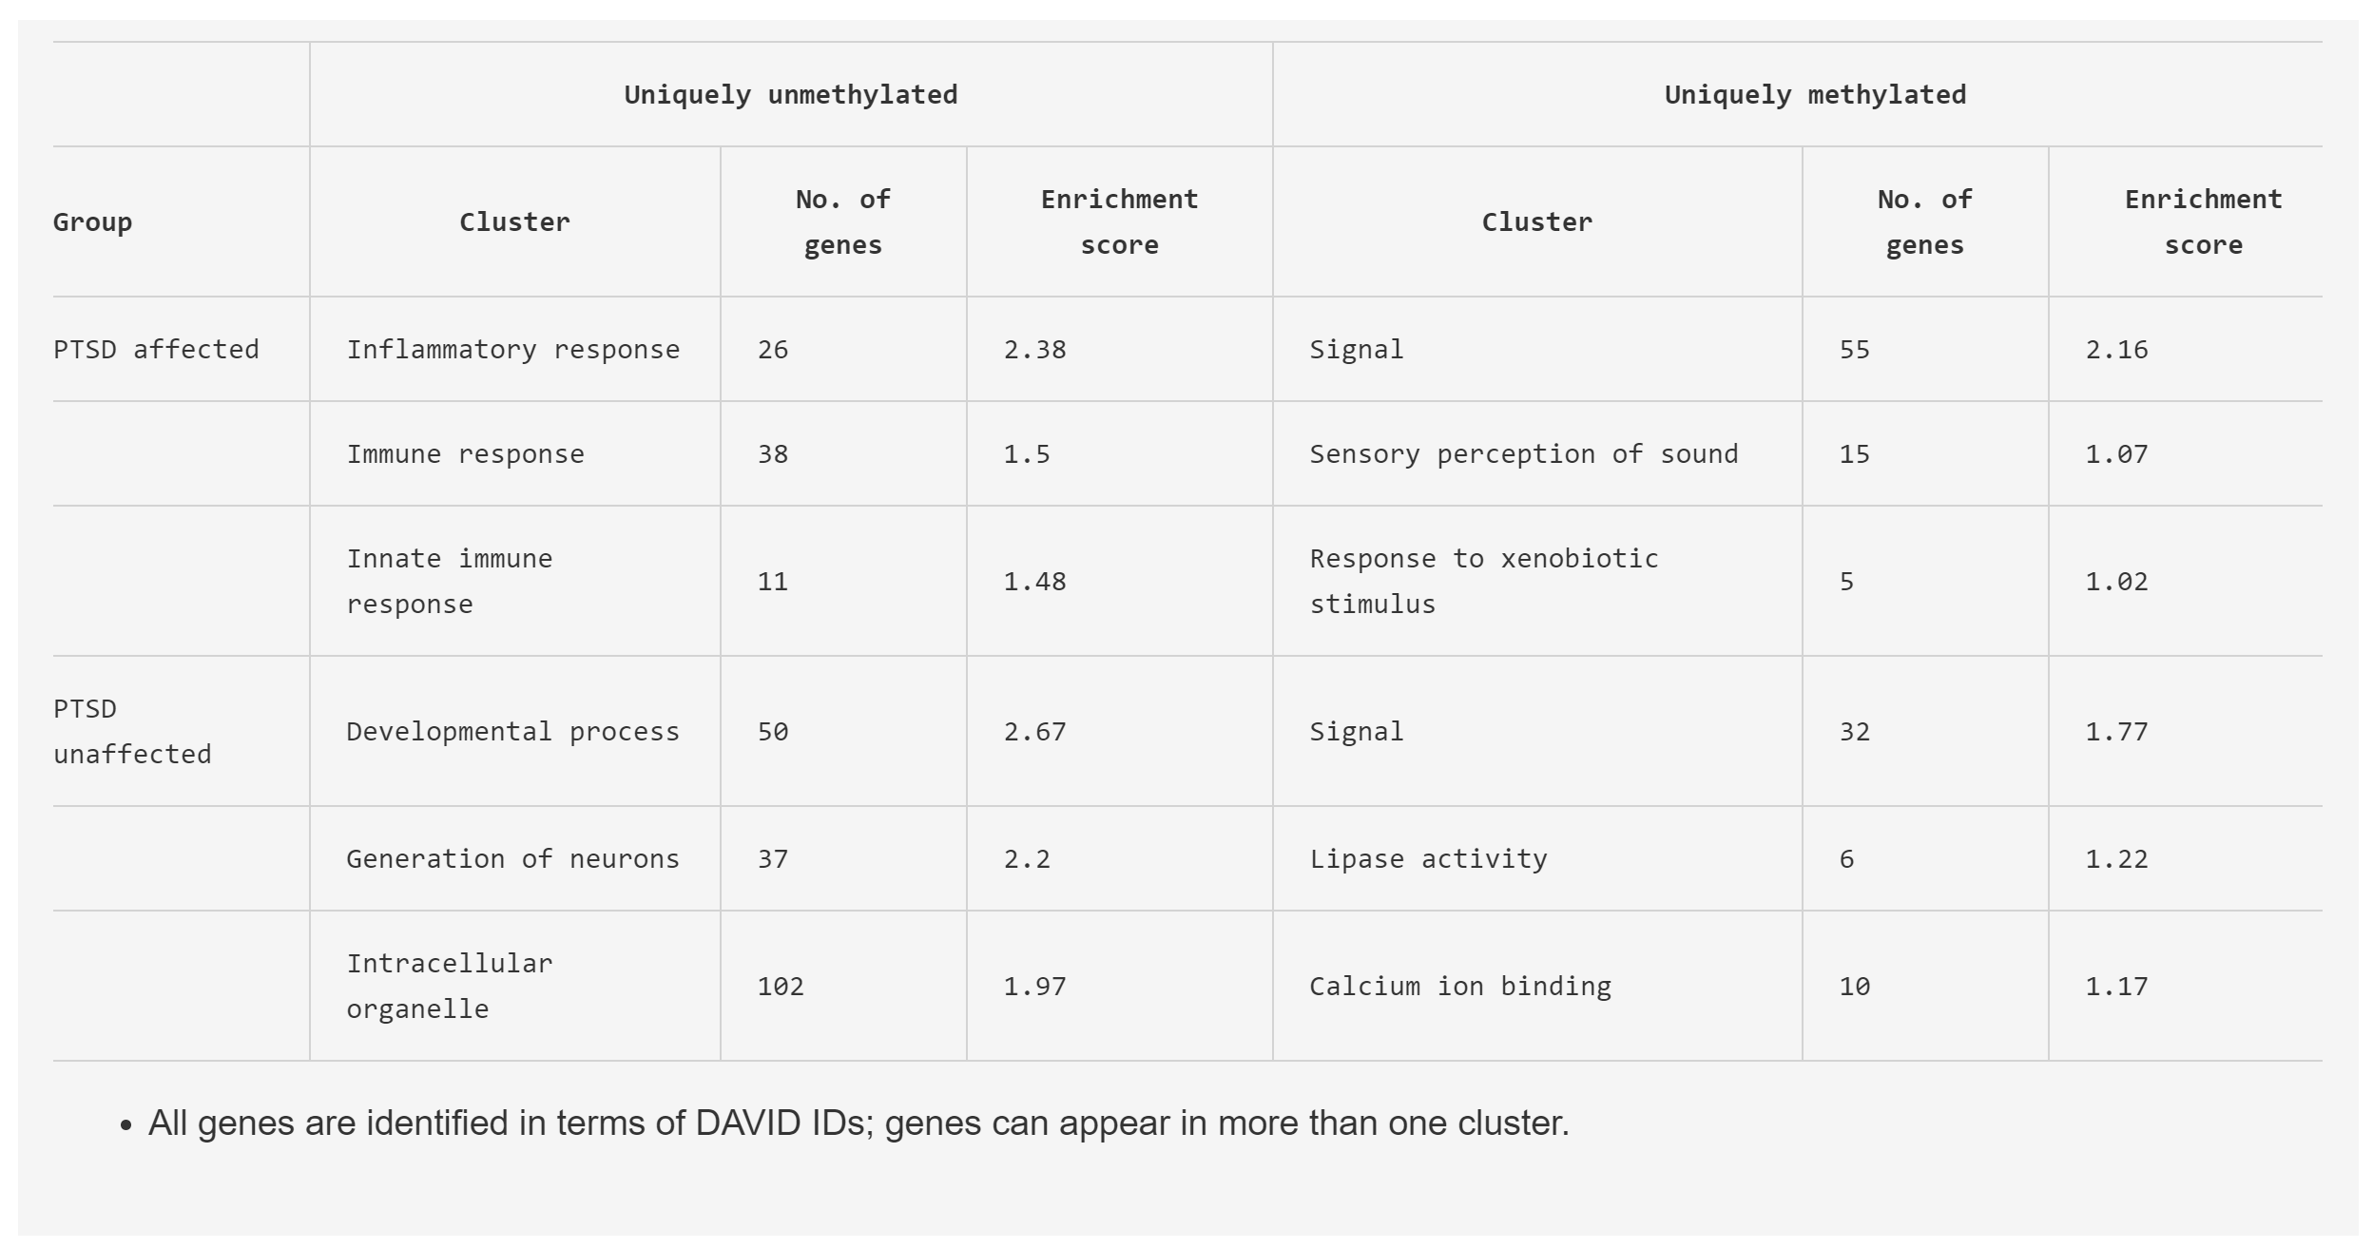

Slide 25
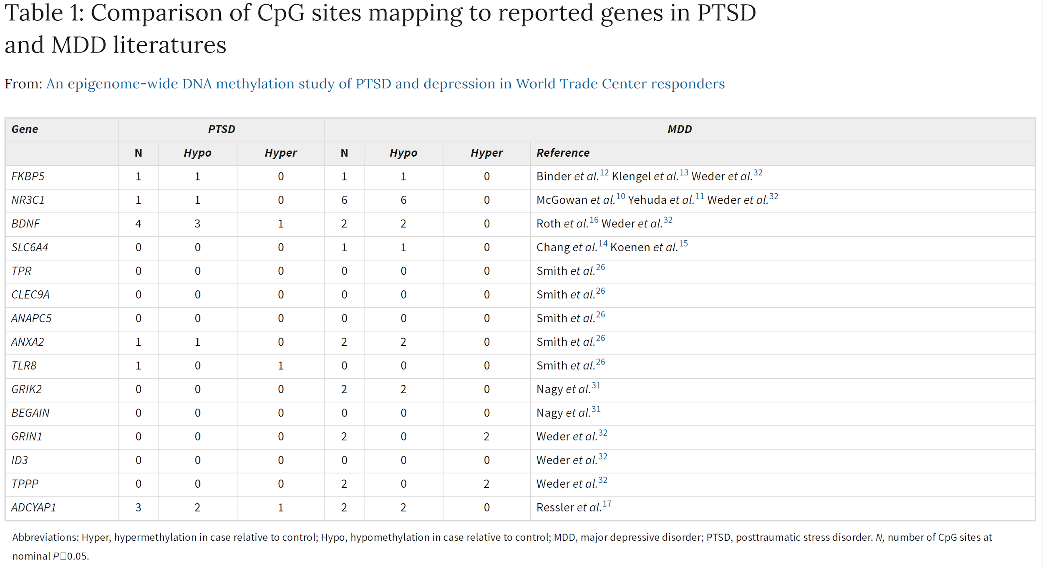
Figure 4
Kuan, P-F, et al. An epigenome-wide DNA methylation study of PTSD and depression in World Trade Center responders. Translational Psychiatry 7, 1-8 (2017).

